Slide 1


Angular – Project Creation
V21 - 5 Project

Slide 2
General Steps
Install TortoiseSVN
Install Visual Studio SVN extension
Checkout project from SVN to local machine
Install node_modules in Angular Project

Slide 3
TORTOISESVN Installation
When running TortoiseSVN setup you will be prompted with the screen in figure 1
Then click on the X next to the command line tools and select Will be installed on local hard drive then it will appear as In figure 2, lastly proceed normally till finish

Slide 4
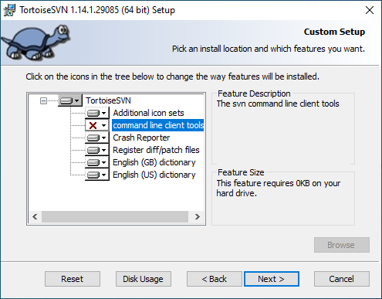
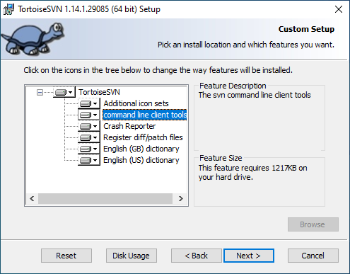
TORTOISESVN Installation
Figure 1
Figure 2

Slide 5
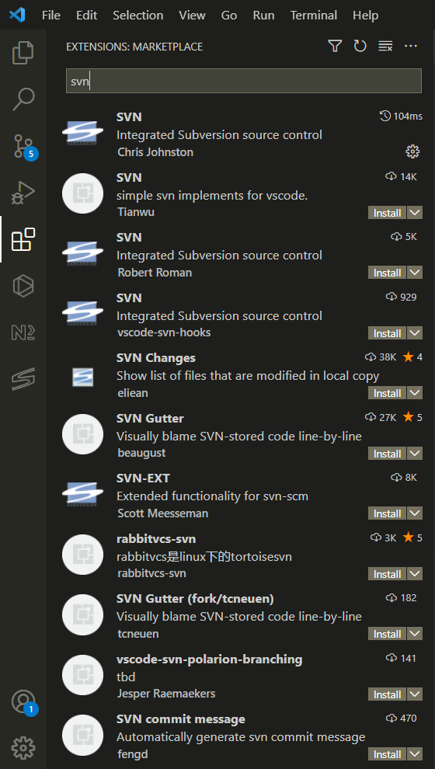
Visual Studio SVN Extension
Open Visual Studio Code and Navigate to Marketplace
Then search for SVN as shown in figure 1
Then click on install
Figure 1

Slide 6
Checkout Project from SVN to local machine
Navigate to SVN then locate the Angular Project, right click on it then click copy URL
Then Navigate to the directory on your local machine where the project will be checked out
Then right click and select SVN Checkout as shown in Figure 1 then an interface will pop as shown in Figure 2
Once the SVN URL is set + the local directory where the Angular project will be saved click on ok, it will recursively download the project as shown in Figure 3

Slide 7
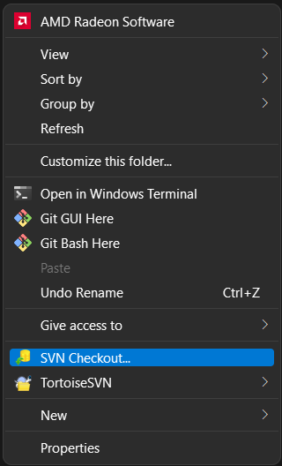
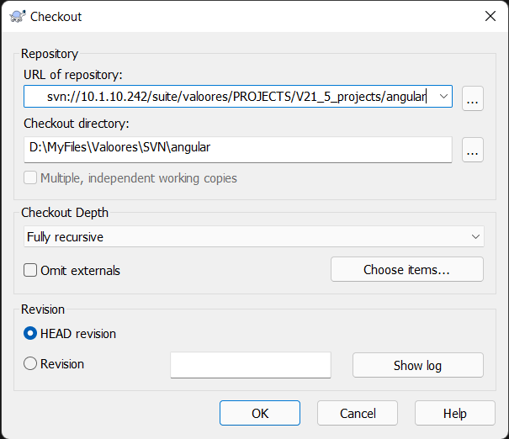
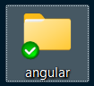
Checkout Project from SVN to local machine
Figure 3
Figure 1
Figure 2

Slide 8
Install node_modules in angular project
Once the above steps are done, launch Visual Studio Code and open your project
In Visual Studio’s terminal or by using Command Prompt, run npm install or npm ci inside your project in order to get node_modules into your project

Slide 9

Thank You

